Slide 1
J.K. Miller - Swazzi
MHR 3020:
Haley Ajimine (7,8), Eric Sok (11,12), Dillon Proud (2,3), Alexandra Morales (8,9), David Davoodi (5,6)

Slide 2
Swazzi: Main Issues
Problem 1: Lack of Leadership
Problem 2: Vague & Unclear Values
David Davoodi
Haley Ajimine
Problem 3: Ineffective Compensation System
Problem 4: Poor Applicant Selection
Alexandra Morales
Eric Sok

Slide 3
Our 4 Step Plan
Unfreezing
Solution 1: Institute New Leadership Structure
Solution 2: Reaffirm & Educate Core Values
David Davoodi
Haley Ajimine
Solution 3: Redesign Commission System
Solution 4: Revise Future Screening Process
Alexandra Morales
Eric Sok
Movement
Refreezing

Slide 4


Step 1: Institute New Leadership Structure
Tangibles we want to accomplish:
Establish new leaders with definitive titles for different departments
i.e. “leads”; “managers”; “supervisors”
Select top sales and more experienced performers & inform of new role
Create Store Hierarchy and explain it to all employees
Create sense of team culture within new leaders and other associates
Ex. Train all of new leaders together
Assign and review new responsibilities
More administrative function
Slightly higher hourly pay
David Davoodi
Notes:
David davoodi

Slide 5
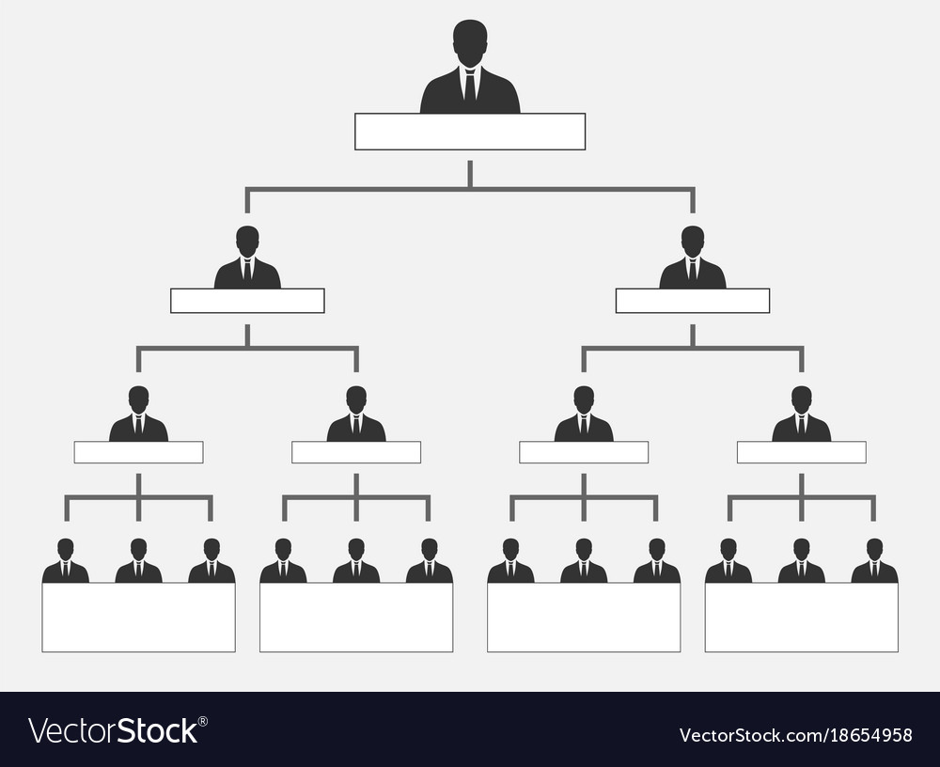

OB Application/Reasoning
Path goal theory: A theory stating it is the leader’s job to assist followers in attaining their goals and to provide the necessary direction/support to ensure goals are compatible with overall objectives of group/organization
More straightforward hierarchy
Allows more successful workers to share their tips
Task Structure: the degree to which job assignments are regimented
Saving more complex functions for more experienced
Faster, more effective service
Transformational Leaders: leaders who inspire, act as role models, and intellectually stimulate, develop, or mentor their followers
Putting best employees in a position of power to create bigger change
David Davoodi

Slide 6


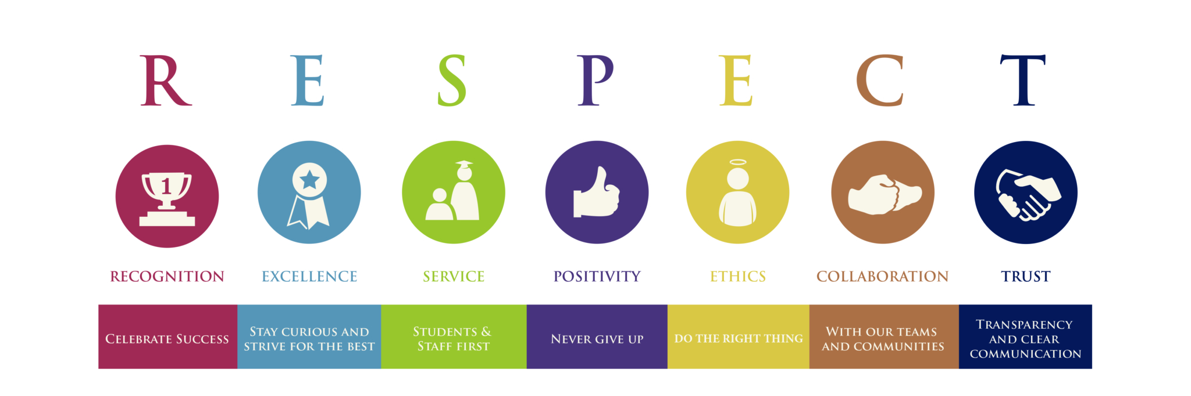
Step 2: Reaffirm & Educate Core Values
Tangibles we want to accomplish:
Create a mission statement that is succinct and clearly spells out the organizational values
I.e. positive customer relations, exceptional service, passion for fashion
The core values should also be ones that workers can closely identify with
I.e. teamwork; kindness; respect
It would also be helpful to include examples of the expected type of behaviors:
Training video; posters; quizzes(paid)
S.M.A.R.T. goals for every shift
Re-educating workers on the core values
My personal experience
Holding monthly/seasonal meetings to educate on new trends/issues:
Daily check-in’s/run downs before a shift
Specific stats/ratios focused on
Getting feedback/ideas from employees
Haley Ajimine
Notes:
Alexandra Morales

Slide 7
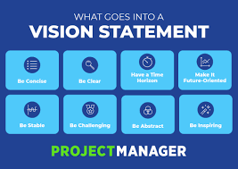
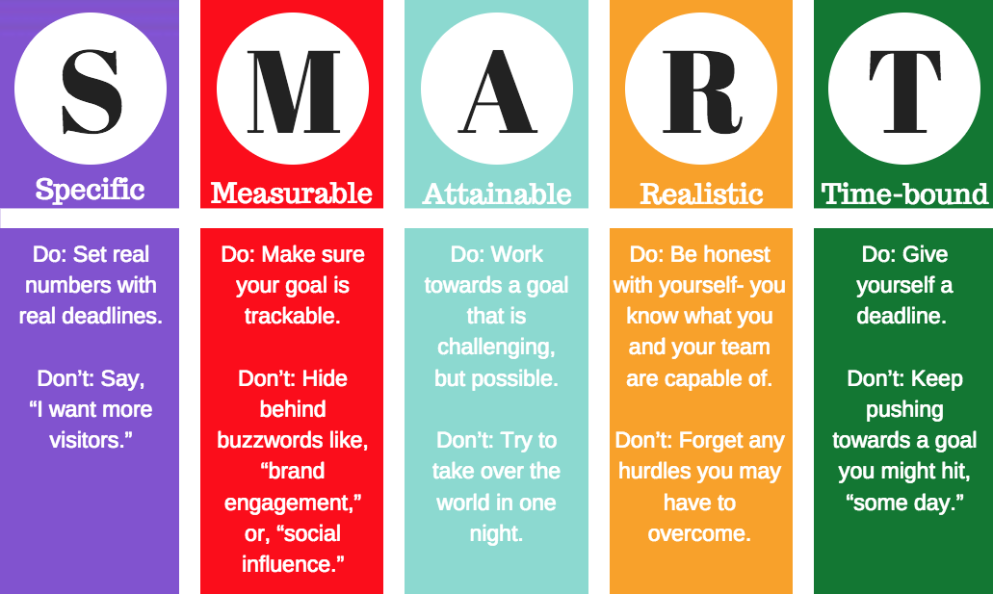
OB Application/Reasoning
Mission Statement: Formal summary of the aims and values of a company, organization, or individual
Core Values: The primary or dominant values that are accepted throughout the organization
Goal Setting Theory: A theory stating that specific and difficult goals, with feedback, lead to higher performance
S.M.A.R.T. goals: Specific, Measurable, Achievable, Realistic, Timely
Haley Ajimine

Slide 8


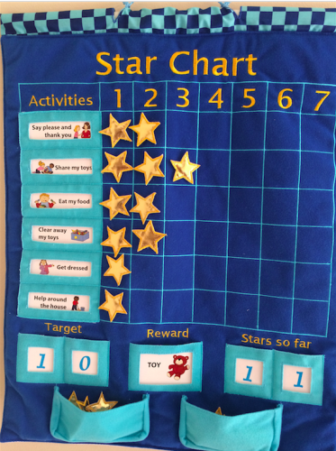

Step 3: Redesign Commission System
Tangibles we want to accomplish:
Have specific goals for them to meet each shift
Visual representation of top performers
Rewards/recognition for consistency or new goals achieved(monthly employee)
Change commission system; schedule based on performance
Have each employee on file - track infractions(absence, tardiness,etc.)
Changes attitude toward work
Eventually over time…
Job Redesign/Terminate
Largest numbers for important ratios - separate prize
Employee Discount
Alexandra Morales

Slide 9


OB Application/Reasoning
Team Building: high interaction among team members to increase trust and openness
Seeing team members rewarded will encourage similar performances
Redesigning jobs: giving employees more responsibility, more meaningful work, more autonomy, and increased feedback gives employees greater control over work activities and can lessen their dependence on others
Organizational Communication: reducing uncertainty by lessening role ambiguity and role conflict
Recognizing the importance of good sales performance and its relationship with compensation/scheduling
Alexandra Morales

Slide 10


Step 4: Revise Future Screening Process
Tangibles we want to accomplish:
Have employees take more qualitative tests to ensure commitment
I.e. internal locus of control; Myer Briggs Type, Enneagram
Truly consider and compare results to qualities needed for job
I.e. introvert + external locus of control may have trouble driving sales
Interview candidates specifically about what they believe the company’s core values to be
Ask for a concrete example of time when candidate exhibited value
Include new leaders in discussion; better idea of social fit for team
Have the candidates perform a simulation of their potential tasks
I.e. shopping exercise for a specific customer/common situation
Determine current skill set
Eric Sok
Notes:
Introverts tend to be quiet and reserved, which is the opposite of what you would want a salesperson to be. An external locus of control means that someone does not believe that they can control what happens to them, but a salesperson should have confidence in themselves to make a sale.

Slide 11


OB Application/Reasoning
Job satisfaction: as the level of contentment employees feel with their job
Job Involvement: degree to which a person identifies with a job, actively participates in it, & considers performance important to self-worth
Organizational Commitment: identifying with a particular organization and its goals and wishing to maintain membership
Eric Sok
Notes:
Go over these three concepts first
Revising the future screening process will filter through potential hires to find the ones that are most likely to have a high job satisfaction, high job involvement, and high organizational commitment, rather than hiring an employee and hoping they’re a good fit. Having an effective screening process is problem prevention rather than problem treatment, so instead of dealing with employees with low job involvement, you prevent hiring employees that you predict will have low job involvement. This will save the company loads of time and money compared to how they currently deal with this issue.

Slide 12
In Conclusion...
Initial Evaluation of Swazzi
Our 4 Step Plan
Step 1: Institute New Leadership Structure
Step 2: Reaffirm & Educate Core Values
Step 3: Revise Future Screening Process
Step 4: Redesign Commission System
OB Theories Used/Application
Thank you!
Dillon Proud

